Slide 1
National Judicial Academy: Conference on Public Trust and Confidence in Justice System
Session 4

Slide 2
NUMBERS SPEAK: PENDENCY IN THE COURTS
Supreme Court: 64,919 cases
Lower Courts:
2,73,60,814 cases
High Courts :
44,79,023 cases
* These are the latest numbers available from the official Supreme Court website - http://supremecourtofindia.nic.in/

Slide 3
Numerous Hearings of Cases In Courts

Slide 4
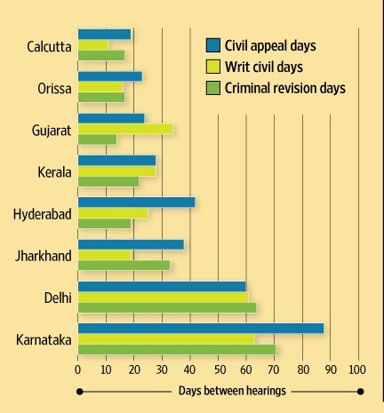
Infrequent hearings of cases
Source: “How cases move through different high courts” by Kian Ganz , August 26, 2015 on http://www.livemint.com/ using DAKSH data

Slide 5
Extremely long life cycle from when case enters system in lower courts to its final disposal
All numbers henceforth are from the DAKSH database where we have collected High Court data from January of 2015 and district court data from May of 2015.

Slide 6
Cricket Scorecard Pressure
As per our High Court data, a judge on average hears 34 cases a day. Given that judges hear cases for about 5 hours a day, this means that per case, they have less than
0
9
0
0
MINUTES
Does this amount of time allow for a fair hearing?

Slide 7
Hugely skewed ratio of admission and disposals
Administration is key to even out this ratio and ensure efficiency

Slide 8
Causes for Diminishing Public Trust in the Judicial System
Dysfunctionality of judiciary
Judicial delay is the primary cause for diminishing public trust
Judicial delay is a societal problem -- not just the problem of the judicial system and its actors
Problems of judicial administration and management
Efficient judge performance alone cannot solve the problem
Is everyone in the judiciary serving their purpose?
A judge’s primary responsibility and desire is to write judgments
System does not always stick to the rule of ‘first in, first out’

Slide 9
Thanks!
www.dakshlegal.in

